Slide 1

React Components – Deep Dive
Lists and Keys, Component Lifecycle, CSS Modules
SoftUni Team
Technical Trainers
Software University
https://softuni.bg

Slide 2

Table of Contents
Lists & Keys
Component Lifecycle
UseEffect Hook
CSS Modules
Fetching Data

Slide 3
Have a Question?
sli.do #js-web

Slide 4




Lists and Keys
Identify Items, Reconciliation

Slide 5
Lists and Keys
Using map() we can build collections of elements and include them in JSX using {}
Keys should be given to the elements inside the array to give the elements a stable identity
Keys help React identify which items have changed, are added, or are removed
5

Slide 6

Lists and Keys
Using map() to take an array of numbers and double their values
Rendering Multiple Components
const numbers = [1, 2, 3, 4, 5];
const doubled = numbers.map((number) => number * 2);
console.log(doubled); // [2, 4, 6, 8, 10]
const numbers = [1, 2, 3, 4, 5];
const listItems = numbers.map((number) =>
<li>{number}</li>
);

Slide 7
Basic List Component
Basic List Component looks like
function NumberList(props) {
const numbers = props.numbers;
const listItems = numbers.map((number) =>
<li>{number}</li>
);
return (
<ul>{listItems}</ul>
);
}

Slide 8
Lists and Keys
You can build collections of elements and include them in JSX using {}
Usually lists are rendered inside a component
function NumberList(props) {
const numbers = props.numbers;
const listItems = numbers.map((number) =>
<li>{number}</li>
);
return <ul>{listItems}</ul>;
}

Slide 9

Lists and Keys
When you render an array of elements, React needs a key prop to identify elements for optimization purposes
If they don't have it, you will get
It won't stop your work

Slide 10
Picking a Key
The best way to pick a key is to use a string that uniquely identifies a list item among its siblings
Most often you would use ID's from your data as keys
const todoItems = todos.map((todo) =>
<li key={todo.id}>
{todo.text}
</li>
);

Slide 11
Extracting Components with Keys
Keys only make sense in the context of the surrounding array
function NumberList(props) {
const numbers = props.numbers;
const listItems = numbers.map((number) =>
<ListItem key={number.toString()} value={number} />
);
return (
<ul>
{listItems}
</ul>
);
}
Keep the key on the list item
function ListItem(props) {
return <li>{props.value}</li>;
}

Slide 12
List and Keys
Don't use indexes for keys if the order may change
Keys serve as a hint to React, but they don't get passed to your component
If you need the same value, pass it explicitly as prop with a different name
const content = posts.map((post) =>
<Post
key={post.id} id={post.id} title={post.title}
/>
);

Slide 13
Lists and Keys
Keys don't need to be globally unique (only among their siblings)
const sidebar = (
<ul>
{props.posts.map((post) =>
<li key={post.id}>
{post.title}
</li>
)}
</ul>
);
const posts = [
{id: 1, title: '...', content: '...'},
{id: 2, title: '...', content: '...'}];
const content = props.posts.map((post) =>
<div key={post.id}>
<h3>{post.title}</h3>
<p>{post.content}</p>
</div>);

Slide 14

Component Lifecycle

Slide 15
Component Lifecycle
A component has "lifecycle methods" that can be overridden to run code at times in the process
A component has 3 lifecycle phases
Mounting
Updating
Unmounting
15

Slide 16
Lifecycle Methods
Mounting - where the component and all its children are mounted (created and inserted to the DOM)
Updating - component is re-rendered because changes are made to its props or state
Unmounting - occurs when a component instance is unmounted (removed from the DOM)

Slide 17

Effect Hook

Slide 18
Effect Hook
You most likely perform: data fetching, subscriptions or manually changing the DOM
Operations like these are called side effects
They can affect other components and can't be done during the rendering
useEffect hook adds the ability to perform side effects from a function component
18

Slide 19
Effect Hook
useEffect hook serves the same purpose as
componentDidMount
componentDidUpdate
componentWillUnmount
But they are bundled into a single API
Import { useEffect } from 'react';

Slide 20
Effect Hook
useEffect hook accepts a function that contains imperative, possibly effectful code
That function will run after the render is committed to the screen
By default effects run after every completed render
But you can choose to fire them only when certain value have changed

Slide 21
Effect Hook
import React, { useState, useEffect } from 'react';
const counter = () {
const [count, setCount] = useState(0);
// Similar to componentDidMount and componentDidUpdate
useEffect(() => {
document.title = `The counter reached: ${count} times`;
});
// ...
}

Slide 22
Effect Hook
When you call useEffect you're telling React to run your "effect" function after flushing changes to the DOM
Effects are declared inside the component so they have access to its props and state
Effects may also optionally specify how to "clean up" after them by returning a function

Slide 23
Effect Hook
Often, effects create resources that need to be cleaned up before the component leaves the screen
To do this, the function passed to useEffect may return a clean-up function
useEffect(() => {
const subscription = props.source.subscribe();
return () => {
// Clean up the subscription
subscription.unsubscribe();
};
});

Slide 24

Effect Hook Demo

Slide 25

CSS Modules

Slide 26
CSS Modules
CSS files in which all class names and animation names are scoped locally by default
All URLs and imports are relative
Importing CSS Module from a JS Module
Exports an object with all mapping from local names to global names
26

Slide 27
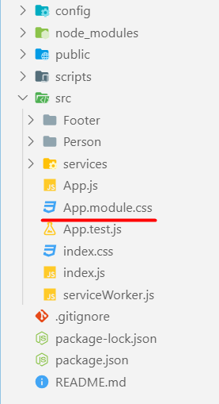
CSS Modules
React supports CSS Modules alongside regular stylesheet using the [name].module.css file naming convention
.App {
text-align: center;
}
.btn {
background-color: green;
color: white;
border-radius: 15px;
margin: 2%;
padding: 0.5%;
font-size: 24px;
cursor: pointer;
}

Slide 28
CSS Modules
CSS Modules let you use the same CSS class name in different file without worrying about naming clashes
.error {
background-color: white;
color: red;
}
CSS File called Button.module.css
import React, { Component } from 'react';
import styles from './Button.module.css';
class Button extends Component {
render() {
return <button className={styles.error}>Error Button</button>;
}
}
Importing all styles
Using error class from the css file

Slide 29

Using Fetch API
Fetching Remote Data

Slide 30
Fetch API
The Fetch API provides an interface for accessing and manipulating requests and responses
fetch() function which provides easy way to fetch resources asynchronously
Functionality like this was previously achieved using XMLHttpRequest
30

Slide 31
Fetch API
fetch() takes one mandatory argument (the path to the resource you want to fetch)
Second argument is optionally (init options - object)
returns a promise
Once response is retrieved, there are several methods that defines what and how should be handled

Slide 32
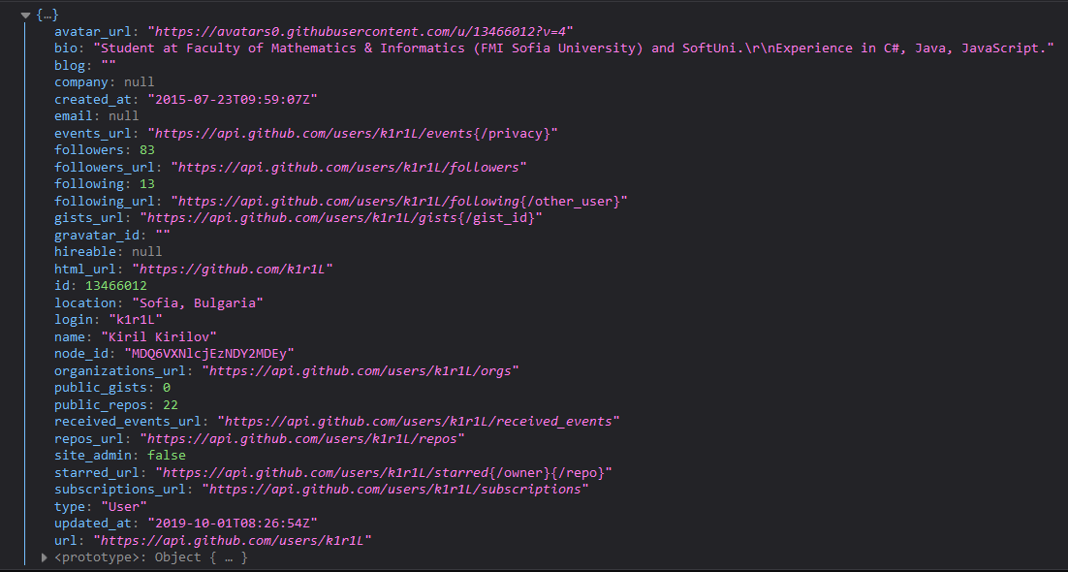
Fetch API
Fetch API with then/catch example
fetch('https://api.github.com/users/k1r1L')
.then((response) => response.json())
.then((myJson) => console.log(myJson))
.catch((myErr) => console.error(myErr));

Slide 33
Fetch API
Fetch API with async/await example
(async () => {
try {
const response = await fetch('https://api.github.com/users/k1r1L');
const myJson = await response.json();
console.log(myJson);
} catch (myErr) {
console.error(myErr);
}
})();

Slide 34
Fetch Services
The basic idea is to isolate the concern of fetching data inside components
Fetching data logic should separated as service
const apiUrl = '...';
export const getData = () => {
return fetch(apiUrl)
.then(res => res.json())
.then(data => data.results)
.catch(error => console.error(error))
};

Slide 35
Fetch Service
Import the useState and useEffect hooks
import { useState, useEffect } from 'react';
import { getData } from './services/fetching-data-service';
function App() {
const [state, setState] = useState({ data: [], isLoading: false });
useEffect(() => {
setState((state) => ({ ...state, isLoading: true }));
getData().then((data) => {
setState((state) => ({ ...state, data, isLoading: false }));
});
}, []);
Import the service
Using the useState hook
Using the useEffect hook
Using the service

Slide 36
Fetch Service
return (
<div className='container'>
{state.data.map((x) => (<p key={x.id}> {x.text}</p>))}
</div>
);
}
export default App;
Return the HTML structure

Slide 37
Demo

Slide 38

Summary
Lists and Keys
Collection of components with unique key
Component Lifecycle
Mounting, Update and Unmounting
UseEffect HOOK
CSS Modules
Using the Fetch API
…
…
…

Slide 39
Questions?
Notes:
39

Slide 40












SoftUni Diamond Partners

Slide 41


Educational Partners

Slide 42
Trainings @ Software University (SoftUni)
Software University – High-Quality Education, Profession and Job for Software Developers
softuni.bg, about.softuni.bg
Software University Foundation
softuni.foundation
Software University @ Facebook
facebook.com/SoftwareUniversity
Software University Forums
forum.softuni.bg
42
Notes:
42

Slide 43

License
This course (slides, examples, demos, exercises, homework, documents, videos and other assets) is copyrighted content
Unauthorized copy, reproduction or use is illegal
© SoftUni – https://about.softuni.bg
© Software University – https://softuni.bg
Notes:
43

